Slide 1
Lecture 9
Nonpremixed Turbulent Combustion:
Experimental data and basic concepts
14.-1

Slide 2
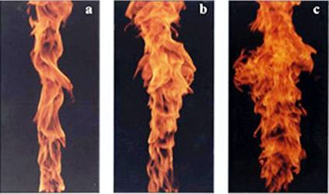
L. Muniz & M. G. Mungal, C&F (2001):
Soot visualisation in diffusion flames with increasing Reynolds number
Re =8,200 Re = 15,600 Re = 24,200

Slide 3
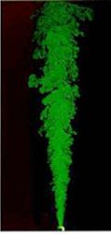
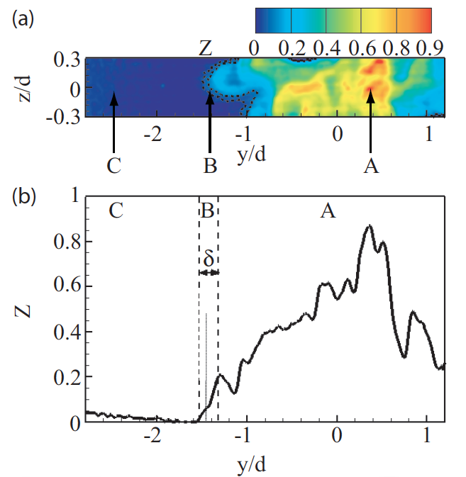
Rayleigh scattering measurements
at the turbulent/non-turbulent (N/NT)
interface of a non-reacting jet
Source: Gampert,M. Narayanaswamy,V. Schaefer,P. Peters,N.
to be published in JFM (2013).

Slide 4
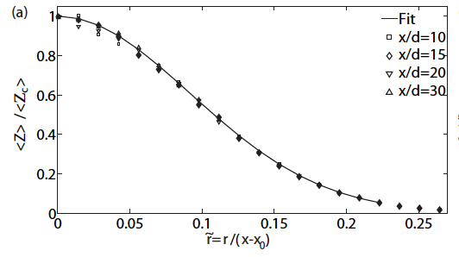
Similarity of the mean scalar profile

Slide 5
For the region at the T/NT interface, a composite model has been developed by Effelsberg and Peters (1983) for the mixture fraction pdf.
It identifies three different contributions to the pdf, from
1) a fully turbulent part ( subscript t),
2) an outer flow part, denoted by a delta function
3) a transition region, the T/NT interface (also called the
laminar superlayer) ( subscript s)
The model shows a bi-modal pdf where the intermediate maximum is due to the contribution from the fully turbulent part of the scalar field.
14.-18

Slide 6
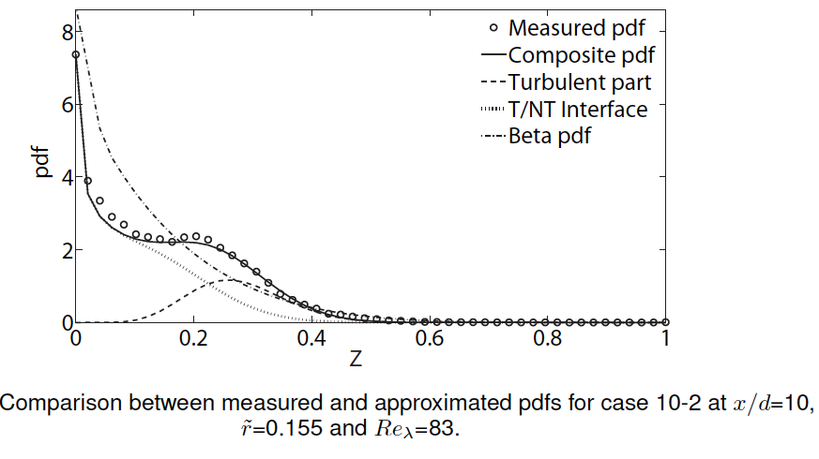

Slide 7
Data from Turbulent Jet Diffusion Flames
There is a large body of experimental data on single point measurements using Laser Rayleigh and Raman scattering techniques combined with Laser-Induced Fluorescence (LIF).
Since a comprehensive review on the subject by Masri et al. (1996) is
available, it suffices to present as an example the results by Barlow et al. (1990) obtained by the combined Raman-Rayleigh-LIF technique.
The fuel stream of the two flames that were investigated consisted of a mixture of 78 mole % H₂ and 22 mole % argon, the nozzle inner diameter d was 5.2 mm and the co-flow air velocity was 9.2 m/s.
The resulting flame length was approximately L = 60 d.
14.-34

Slide 8
Two cases of exit velocities were analyzed, but only the case B with u₀ = 150 m/s will be considered here.
The stable species H₂, O₂, N₂, and H₂O were measured using Raman-scattering at a single point with light from a flash-lamp pumped dye laser.
In addition, quantitative OH radical concentrations from LIF measurements
were obtained by using the instantaneous one-point Raman data to calculate
quenching corrections for each laser shot.
The temperature was calculated for each laser shot by adding number densities of the major species and using the perfect gas law.
14.-35

Slide 9
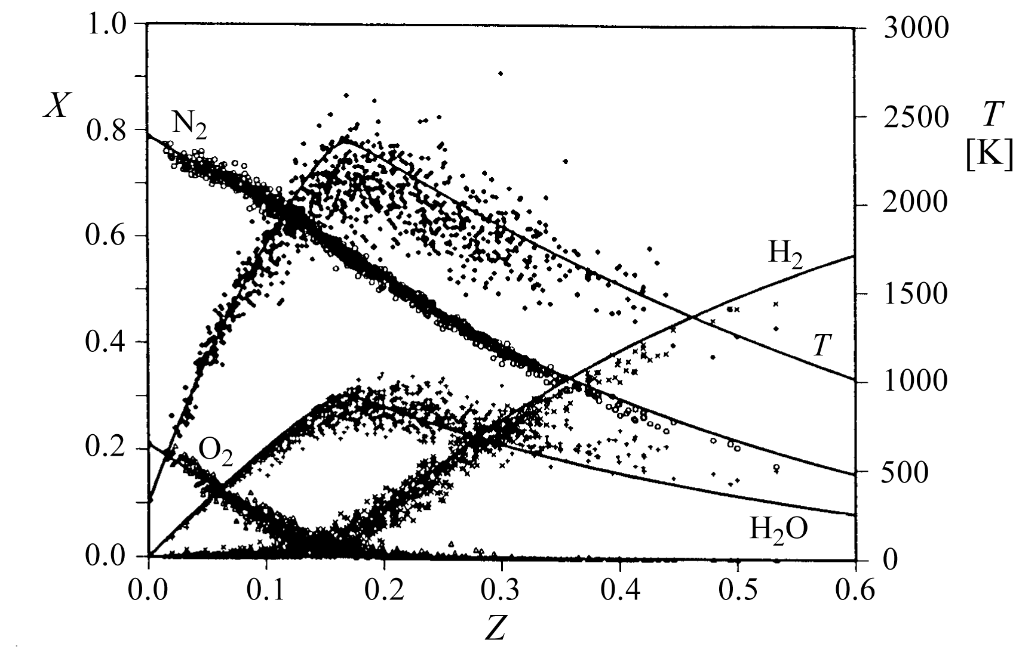
An ensemble of one-point, one-time Raman-scattering measurements of major
species and temperature plotted over mixture fraction are shown in the figure.
They were taken at x/d = 30, r/d = 2 in the case B flame.
Also shown are calculations
based on the assumption of
chemical equilibrium.
14.-36

Slide 10
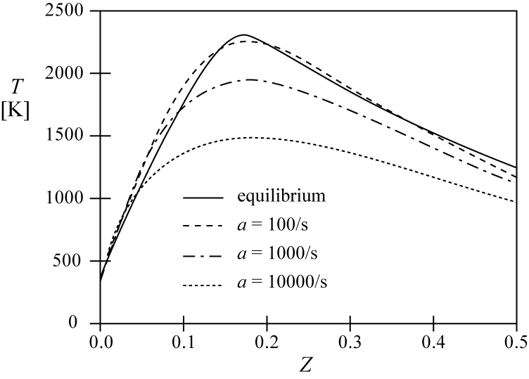
Temperature profiles versus mixture fraction calculated for counterflow diffusion flames at different strain rates
These steady state flamelet profiles display the characteristic decrease of the
maximum temperature with increasing strain rates
(which corresponds to decreasing
Damköhler numbers) as shown
schematically by the
upper branch of the S-shaped
curve.
The strain rates vary here between
a = 100/s which is close to chemical
equilibrium and a = 10000/s.
14.-37

Slide 11
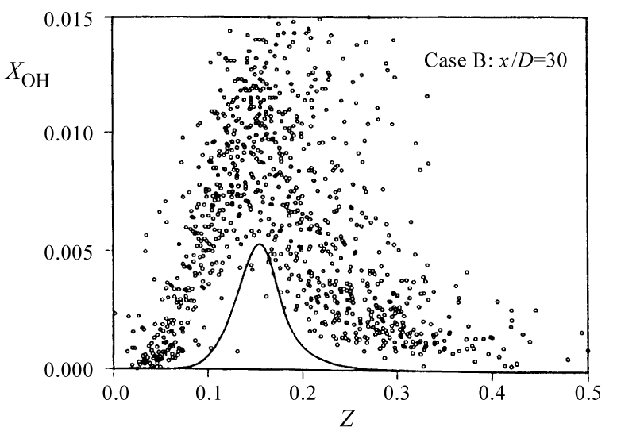
Data of OH-concentrations compared to flamelet calculations for the different
strain rates mentioned before.
It is evident that the local OH-concentrations exceed those of the equilibrium profile by a factor up to 3.
14.-38

Slide 12
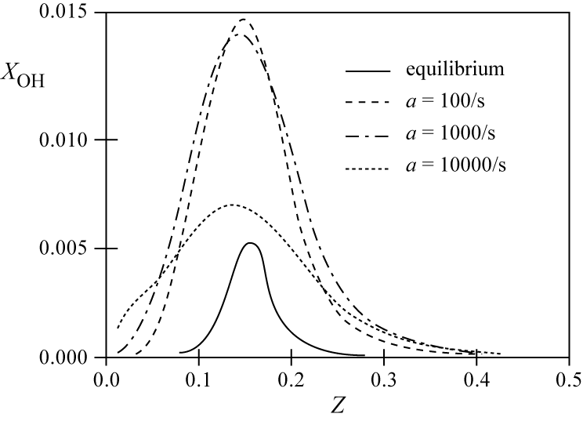
The flamelet calculations show an increase of the maximum values by a factor of 3 already at the low strain rates a = 100/s and a = 1000/s.
The maximum value of a = 10000/s is close to extinction and does not
represent conditions in the turbulent hydrogen flame considered here.
14.-39

Slide 13
In summary, it may be concluded that one-point, one-time experimental data in
turbulent flames, when plotted as a function of mixture fraction, show
qualitatively similar tendencies as laminar flamelet profiles in counterflow
diffusion flames.
Non-equilibrium effects are evident in both cases and lead to an increase
of radical concentrations and a decrease of temperatures.
This has an important influence on NOx formation in turbulent diffusion flames.
14.-40

Slide 14
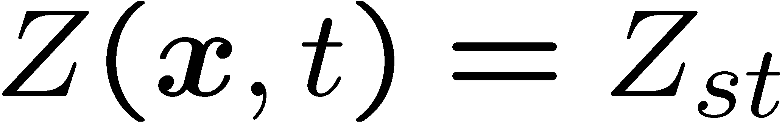
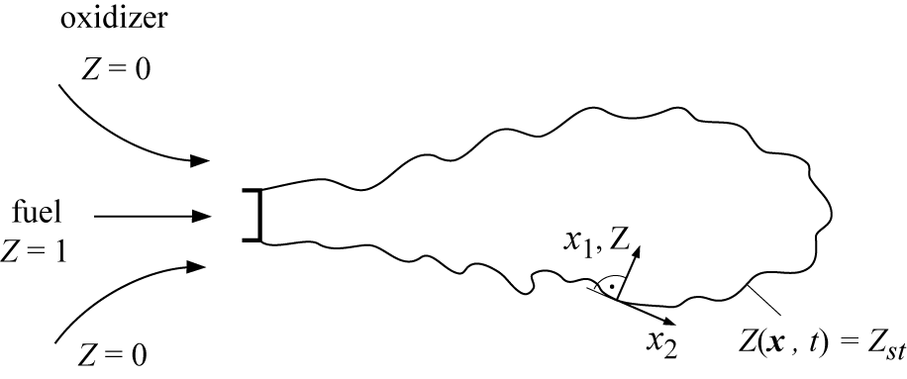
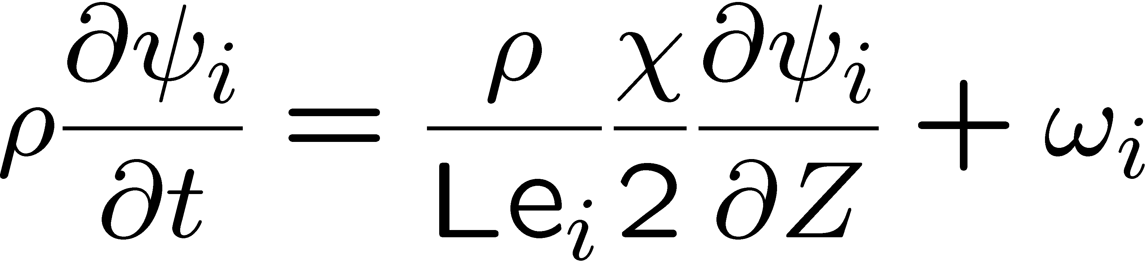
Closure assumptions in the Flamelet Concept for Nonpremixed Combustion
Based on the laminar flamelet concept introduced in Lecture 3 the flame surface is defined as the surface of stoichiometric mixture which is obtained by setting
In the vicinity of that
surface the reactive-diffusive
structure can be described
by the flamelet equations
In these equations the instantaneous scalar dissipation rate has been introduced.
14.-41

Slide 15
At the flame surface the instantaneous scalar dissipation rate takes the value χ_{st}
If χ is assumed to be a function of Z, this functional dependence can be parameterized by χ_{st}.
The scalar dissipation rate acts as an external parameter that is imposed on the flamelet structure by the mixture fraction field.
It has the dimension of an inverse time and therefore represents the inverse of a diffusion time scale.
It also can be thought of as a diffusivity in mixture fraction space.
14.-42

Slide 16
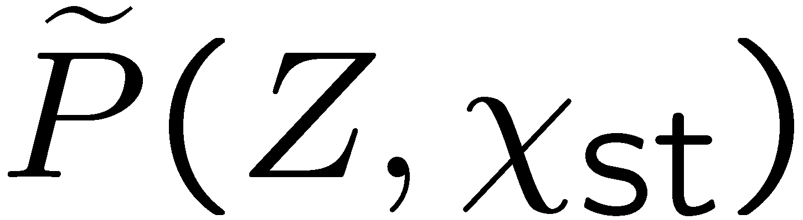
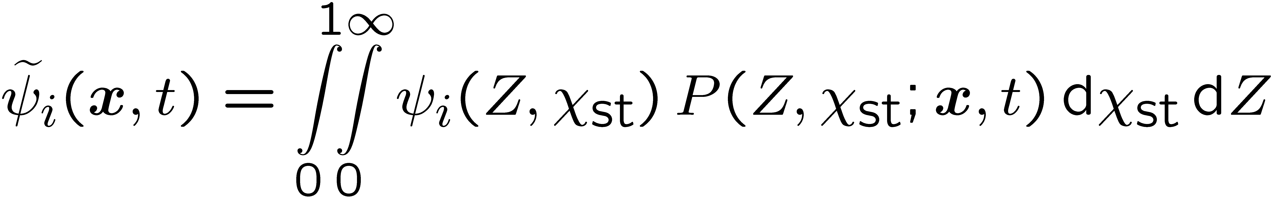
In principle, both the mixture fraction Z and the scalar dissipation rate χ are fluctuating quantities and their statistical distribution needs to be considered,
if one wants to calculate statistical moments of the reactive scalars (cf. Peters, (1984).
If the joint pdf surface, is known, and the steady state flamelet equations are solved to obtain ψ_{i} as a function of Z and χ_{st},
point x and the time t.
The Favre mean of ψ_{i} can be obtained from
For further reading see Peters (1984).
14.-43

Slide 17
If the unsteady term in the flamelet equation must be retained, joint statistics of Z and χ_{st} become impractical.
Then, in order to reduce the dimension of the statistics, it is useful to
introduce multiple flamelets, each representing a different range of the
χ-distribution.
Such multiple flamelets are used in the Eulerian Particle Flamelet Model (EPFM) by Barths et al. (1998).
Then the scalar dissipation rate can be formulated as a function of the mixture
fraction.
14.-44

Slide 18
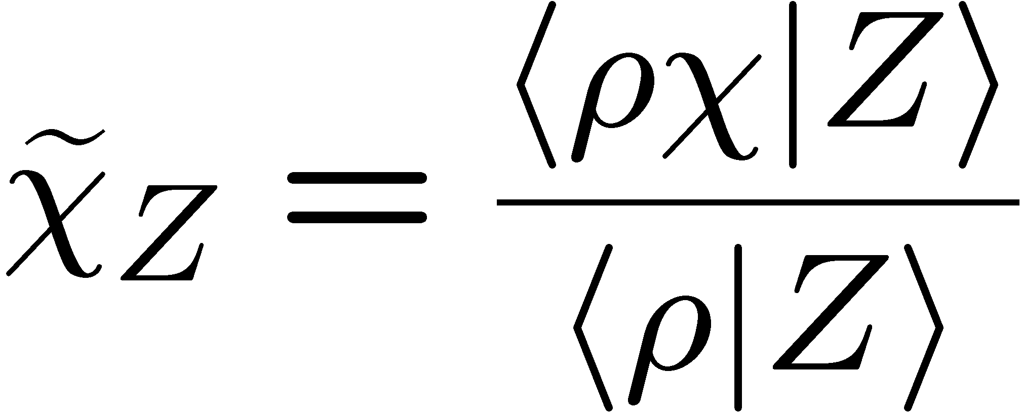
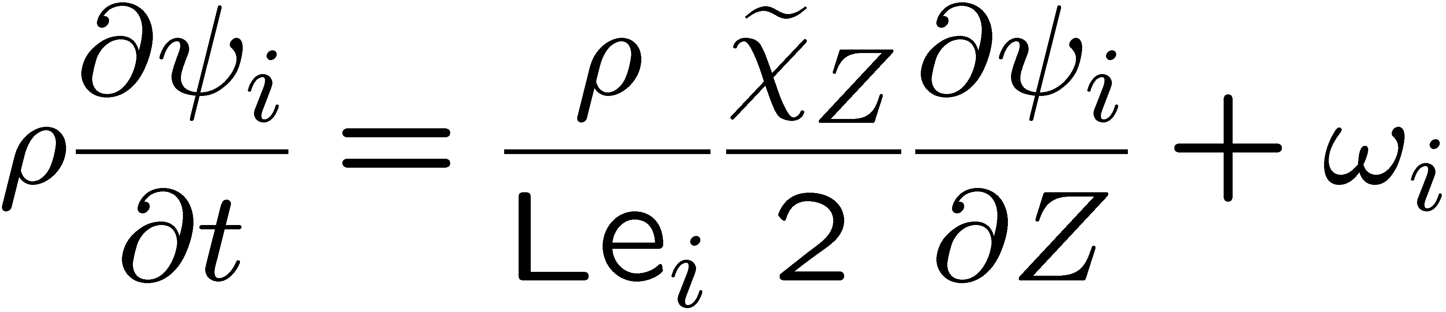
Such a formulation can be used in modeling the conditional Favre mean scalar dissipation rate
Then the flamelet equations in a turbulent flow field take the form
A mean scalar dissipation rate, however, is unable to account for those ignition and extinction events that are triggered by small and large values of χ, respectively.
This is where LES, as discussed in Lecture 3, must be used.
14.-45

Slide 19
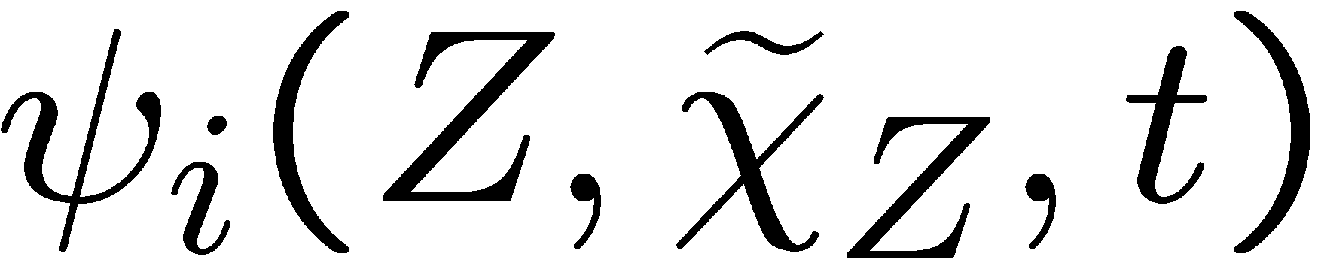
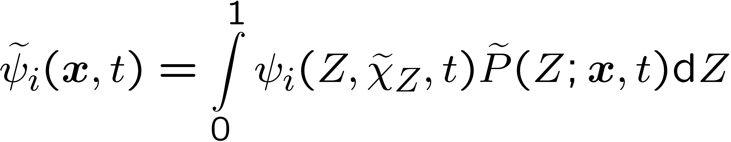
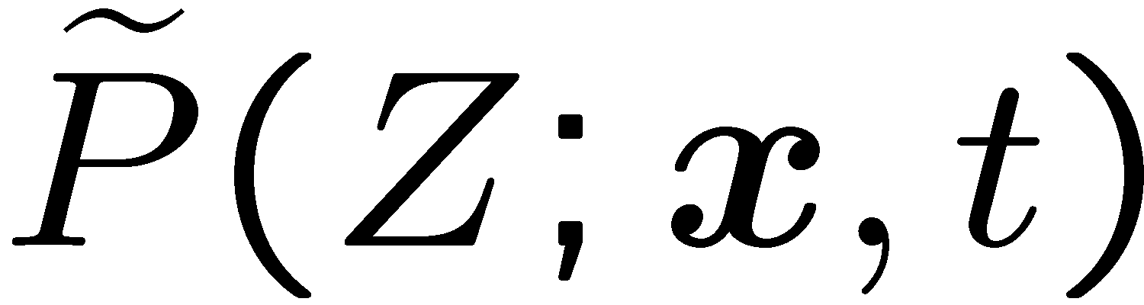
With obtained from solving
Favre mean values of ψ_{i} can be obtained at any point x and time t in the flow
Here the presumed shape of the pdf can be calculated from the mean and the variance of the turbulent mixture fraction field, as discussed in Section 14.1.
14.-46

Slide 20
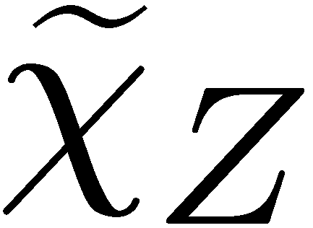
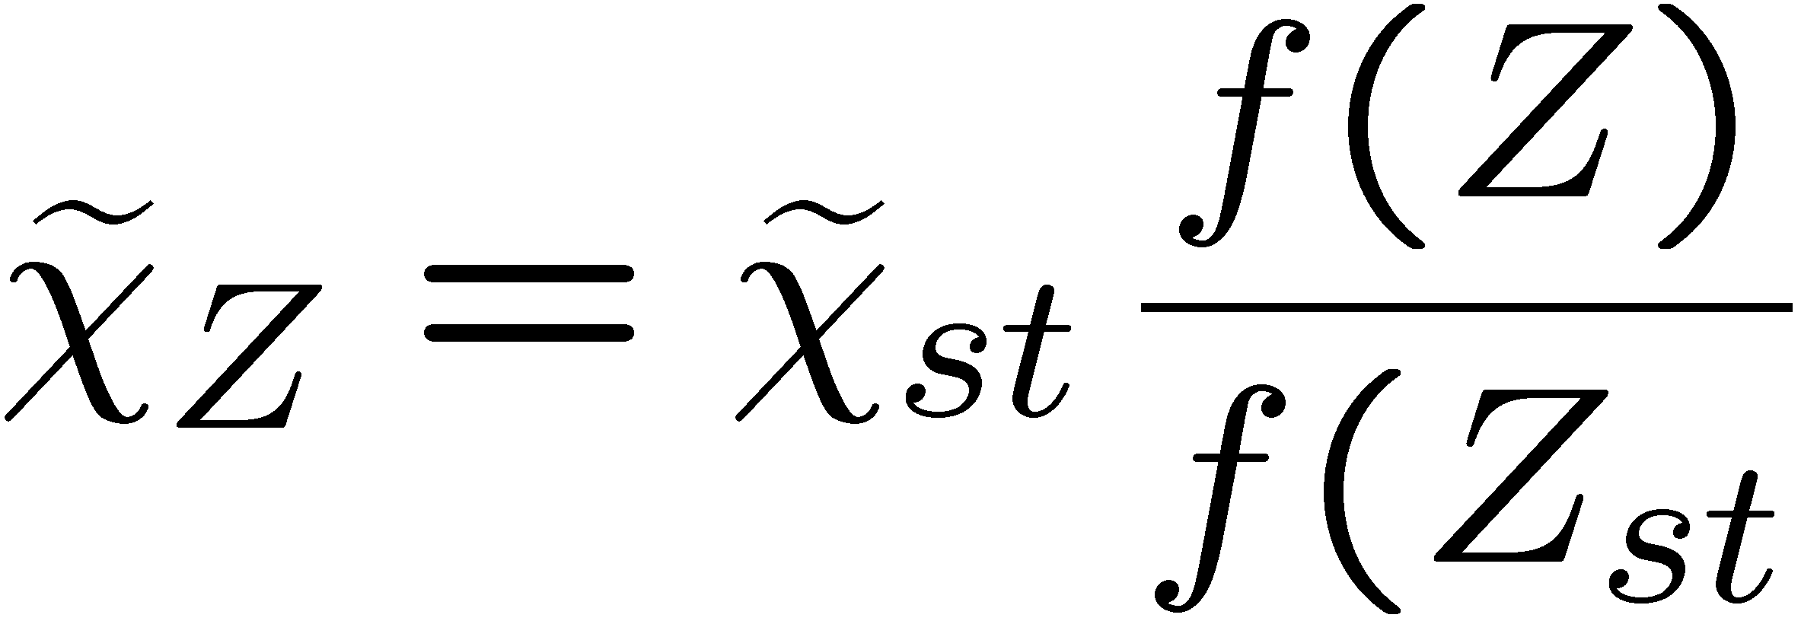
Then there remains the problem on how to model the conditional scalar dissipation rate .
One then relates the conditional scalar dissipation rate to that at a fixed value Z_{st} by
where f(Z) is a function as in
14.-47

Slide 21
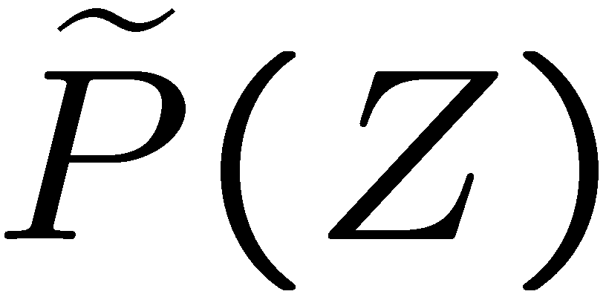
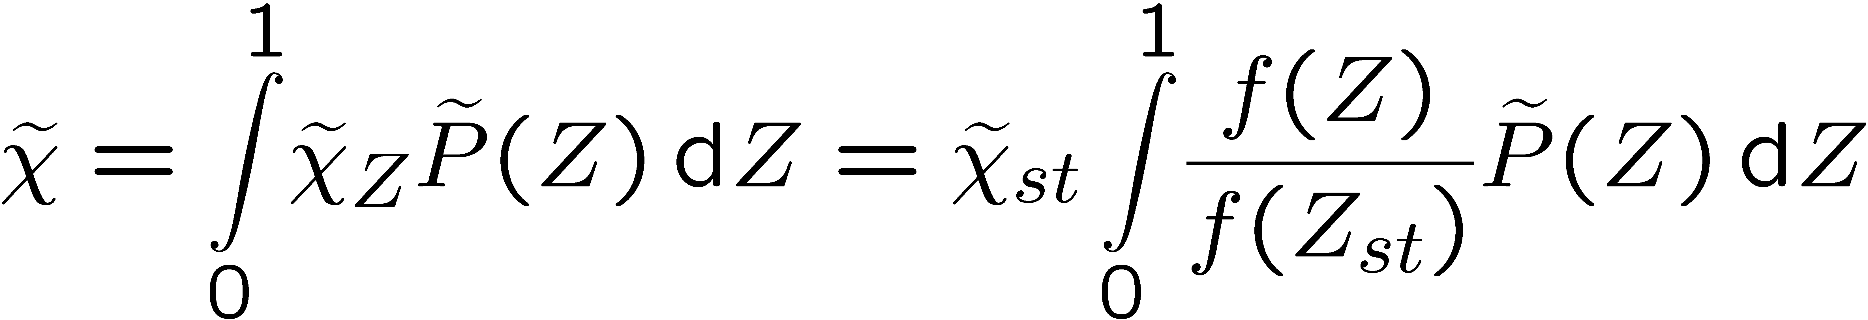
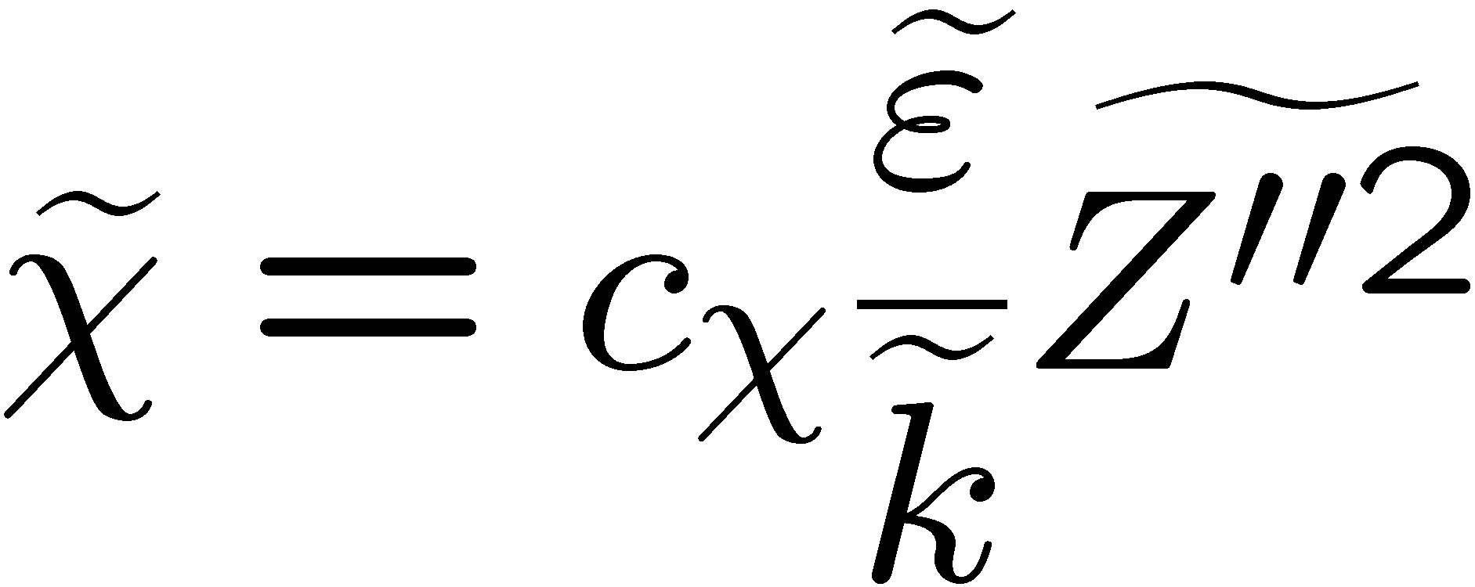
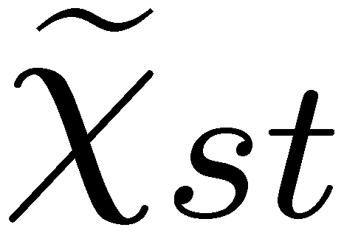
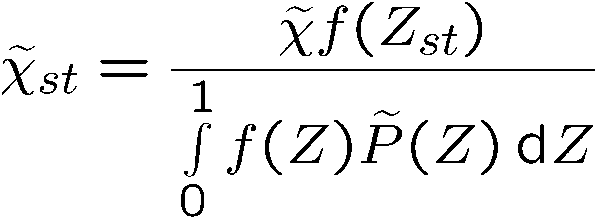
Then, with the presumed pdf being known, the unconditional average can be written as
Therefore, using the model
the conditional mean scalar dissipation rate can be expressed as
which is to be used in .
14.-48

Slide 22
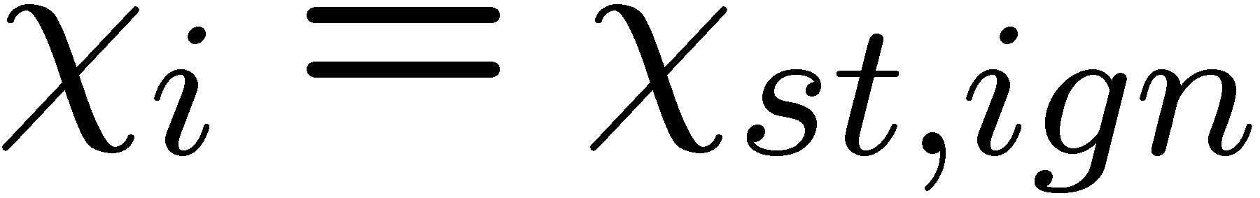
Ignition in a nonpremixed system
As the scalar dissipation rate decreases, as for instance in a Diesel engine after injection, heat release by chemical reactions will exceed heat loss out of the reaction zone, leading to auto-ignition.
The scalar dissipation rate at auto-ignition is denoted by
For ignition under Diesel engine conditions this has been investigated by
Pitsch and Peters (1998).
An example of auto-ignition of a n-heptane-air mixture calculated with the RIF code (cf. Paczko et al. (1999) will be shown here.
14.-49

Slide 23
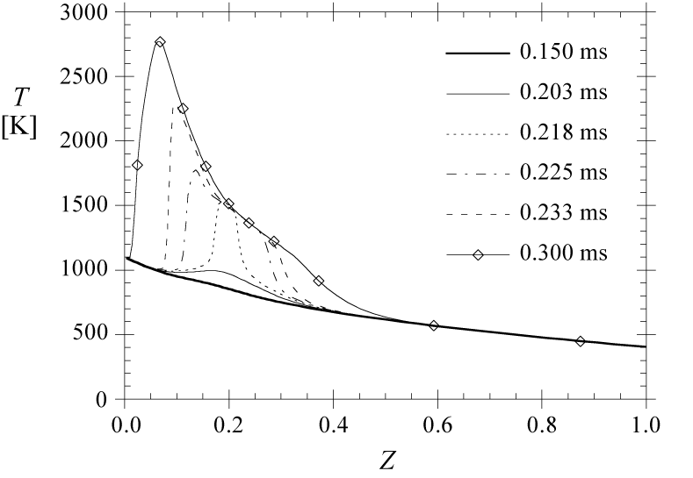
The initial air temperature is 1100 K and the initial fuel temperature
is 400 K.
Mixing of fuel and air leads
to a straight line for the
enthalpy in mixture fraction
space, but not for the
temperature T_{u}(Z),
since the heat capacity
c_{p} depends on temperature.
14.-50

Slide 24
It is seen that auto-ignition
starts after 0.203 ms, when
the temperature profile
shows already a small
increase over a broad region
around Z=0.2.
At t=0.218 ms there has been
a fast thermal runaway in that
region, with a peak at the
adiabatic flame temperature.
14.-51

Slide 25
At t = 0.3 ms most of the mixture, except for a region beyond Z = 0.4 in
mixture fraction space, has reached the equilibrium temperature.
A maximum value of
T = 2750 K is found close to
stoichiometric mixture.
The ignition of n-heptane
mixtures under Diesel
engine condition has
been discussed in detail by
Pitsch and Peters (1998).
There it is shown that auto-ignition under nonpremixed conditions occurs mainly at locations in a turbulent flow field where the scalar dissipation rate is low.
14.-62

Slide 26
From thereon, the temperature profile broadens, which may be interpreted as a propagation of two fronts in mixture fraction space, one towards the lean and the other towards the rich mixture.
Although the transport term
in
contributes to this propagation,
it should be kept in mind that the
mixture is close to auto-ignition
everywhere.
The propagation of an ignition front in mixture fraction space therefore differs considerably from premixed flame propagation.
14.-61

Slide 27
NOx formation in turbulent diffusion flames
This is a problem of great practical importance, but due to the many physical aspects involved, it is also a very demanding test for any combustion model.
A review on the various aspects of the problem has been given by Turns (1995).
A global scaling law for NO production in turbulent jet flames has been derived
by Peters and Donnerhack (1981) assuming equilibrium combustion chemistry and thin NO reaction zone around the maximum temperature in mixture fraction space.
14.-52

Slide 28
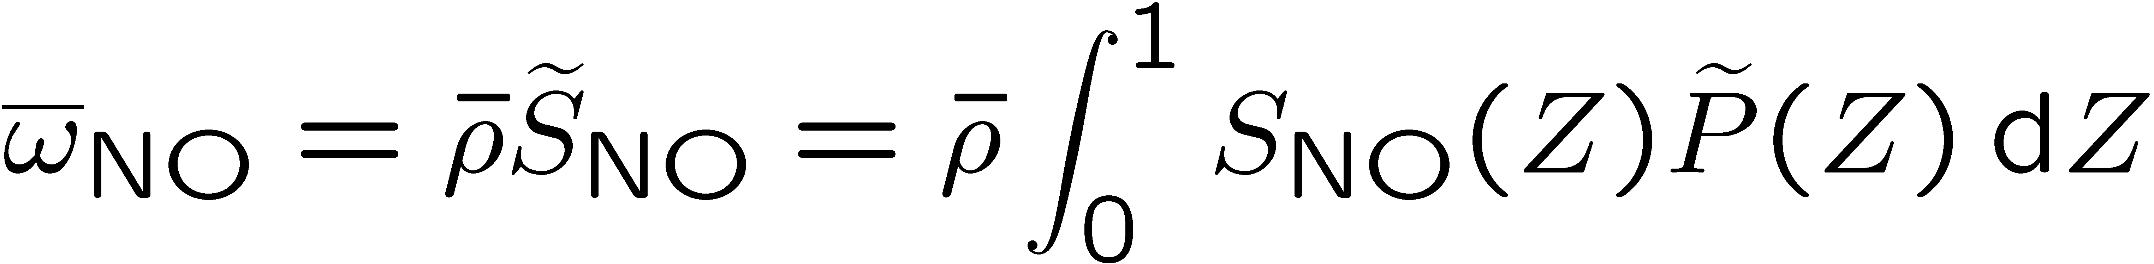
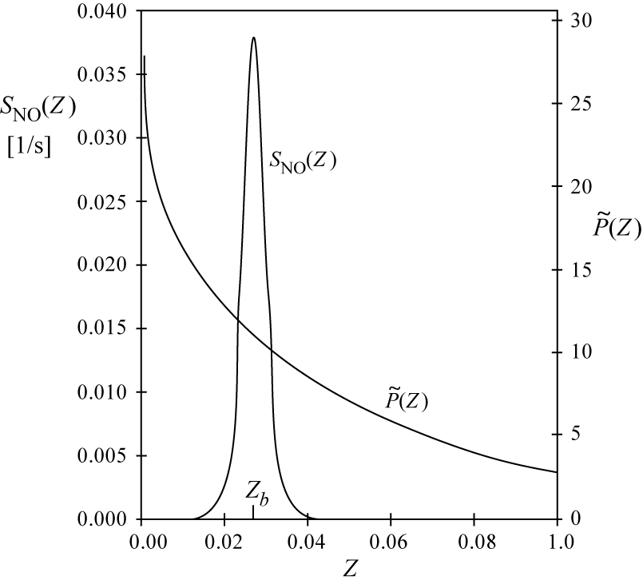
An asymptotic solution for the mean turbulent NO production rate can be obtained by realizing that in the expression
the function S_{NO}(Z) has a very
strong peak in the vicinity of the
maximum temperature, but
decreases very rapidly to
both sides (shown for a
hydrogen flame).
14.-53

Slide 29
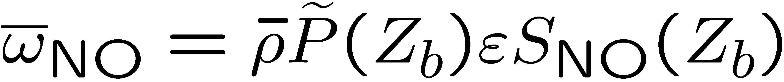
The NO reaction rate acts nearly like a δ-function underneath the integral in
It has been shown by
Peters (1978) and
Janicka and Peters (1982) that
an asymptotic expansion of the
reaction rate around the
maximum temperature leads to
where Z_{b} is the mixture fraction
at the maximum temperature T_{b} and
S_{NO}(Z_{b}) is the maximum reaction rate.
14.-54

Slide 30
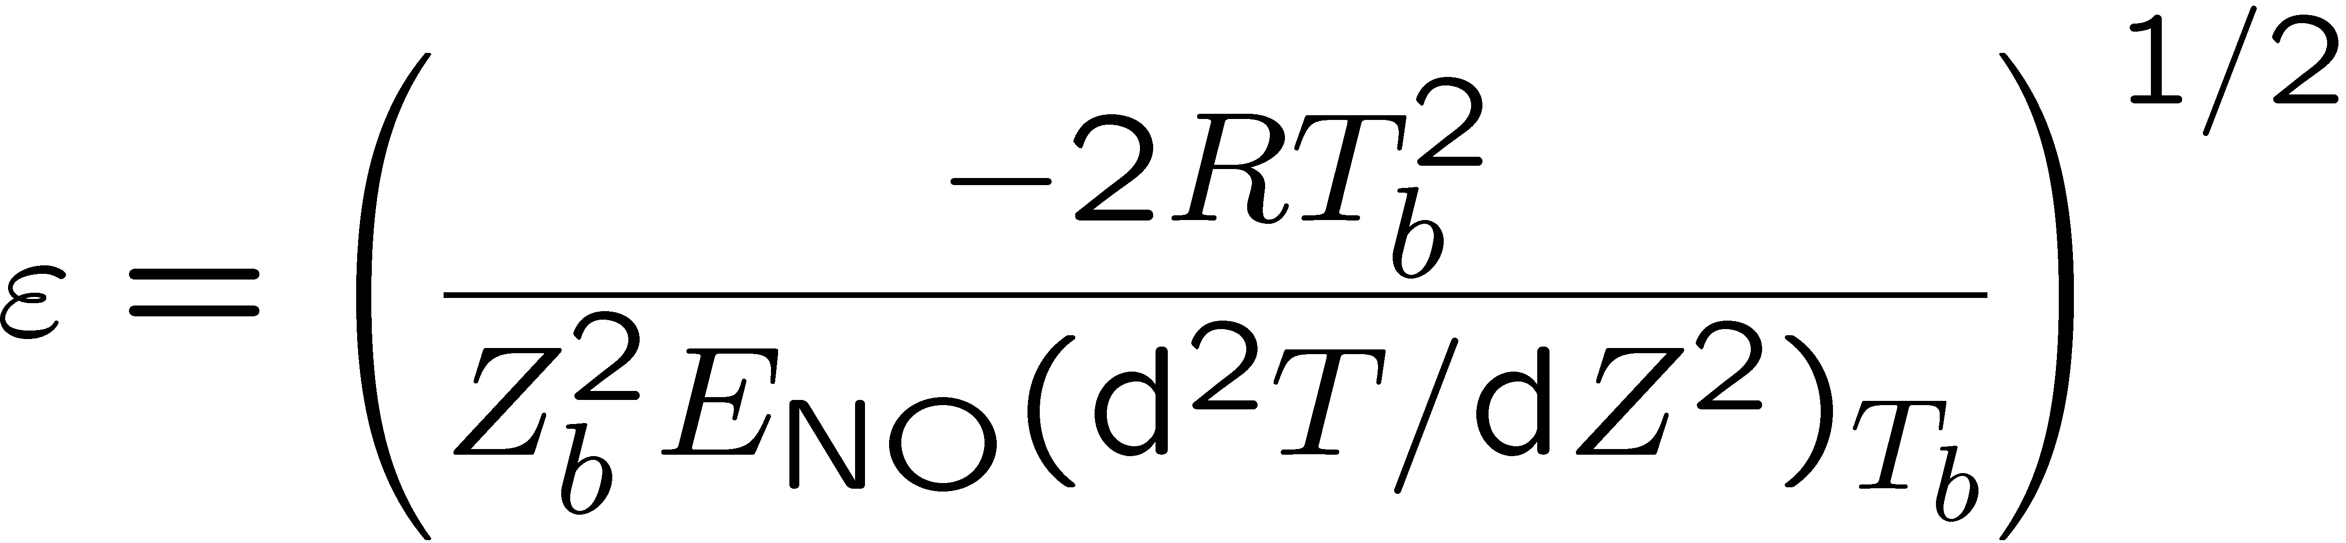
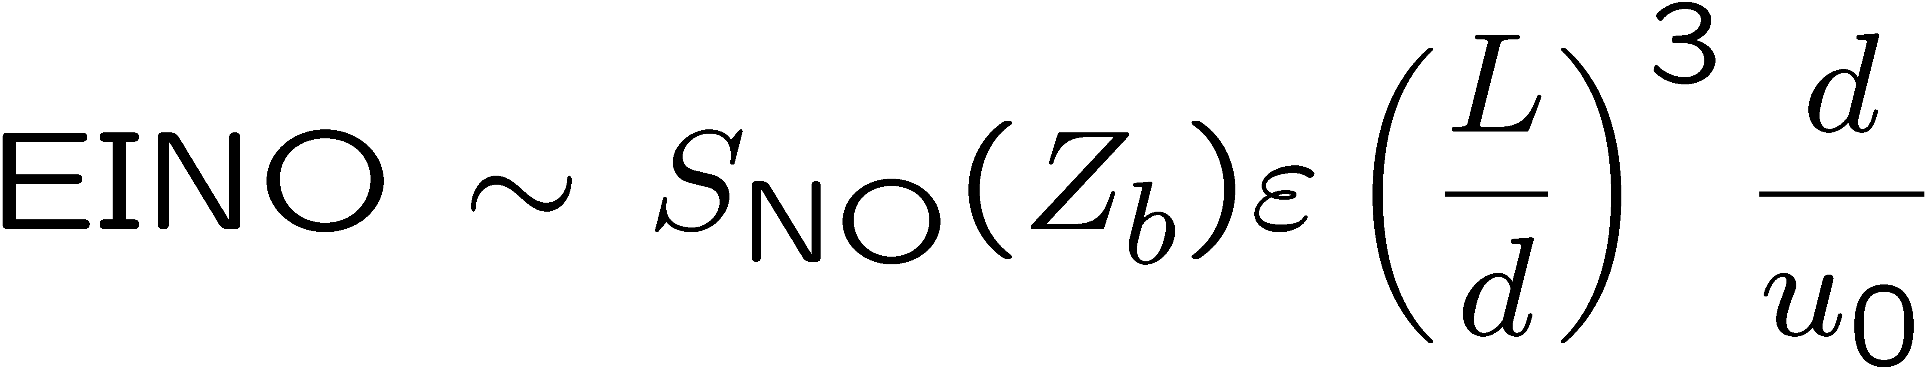
The quantity ε represents the reaction zone thickness of NO production in mixture fraction space.
That quantity was derived from the asymptotic theory as
Here E_{NO} is the activation energy of the NO production rate.
Finally, Peters and Donnerhack (1981) predicted the NO emission index EINO, which represents the total mass flow rate of NO produced per mass flow rate of fuel, as being proportional to
14.-55

Slide 31
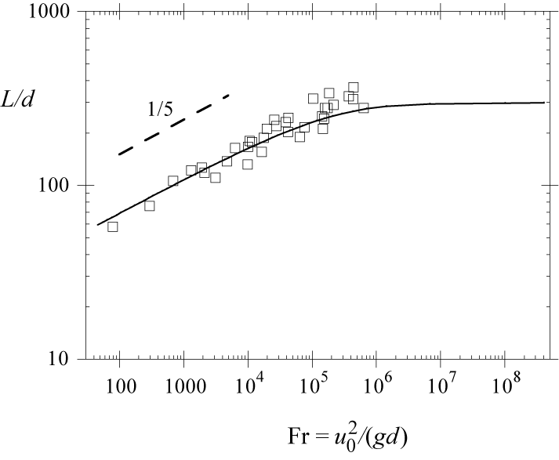
In
L is the flame length, d the nozzle diameter and u₀ the jet exit velocity.
The normalized flame length L/d is
constant for momentum dominated
jets but scales with the Froude
number Fr=u₀²/(gd) as L/d ~ Fr^{1/5}
for buoyancy dominated jets
as shown in the figure.
14.-56

Slide 32
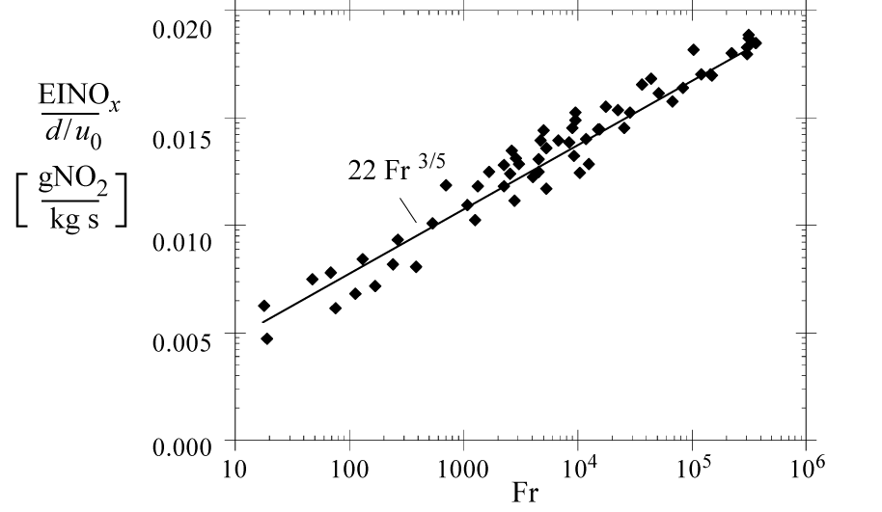
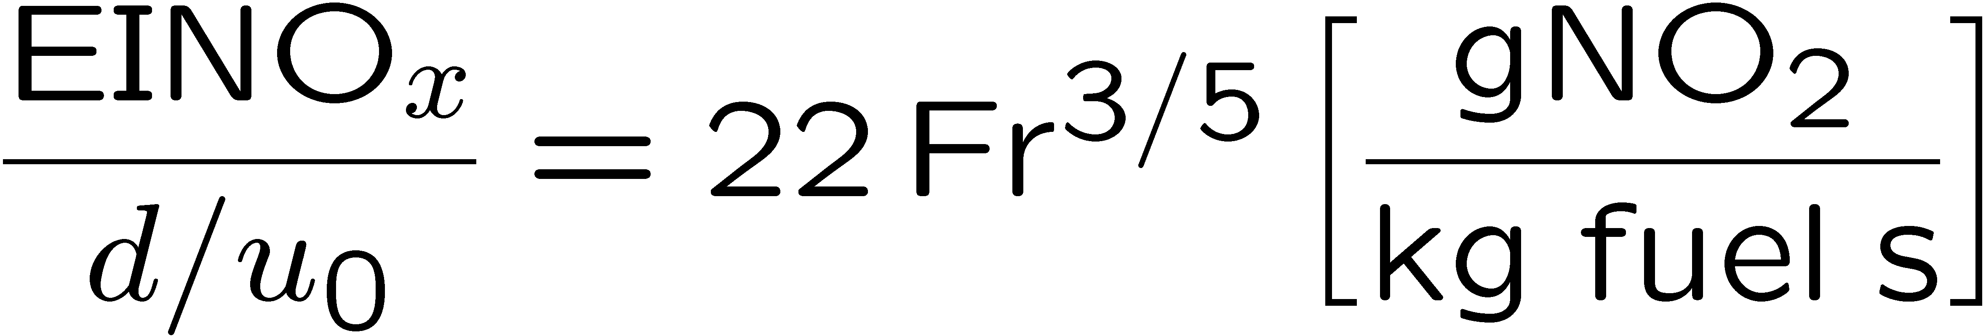
This explains, for instance, the Fr^{3/5} dependence of the emission index found in the buoyancy dominated propane jet diffusion flames of Røkke et al. (1992).
These data are reproduced
here together with the
prediction of the
NO_{x} emission index
(expressed here in
terms of NO₂)
14.-57

Slide 33
An interesting set of experimental data are those by Chen and Driscoll
(1990) and Driscoll et al. (1992) for diluted hydrogen flames.
These data show a square root dependence of them rescaled emission index on the Damköhler number.
An explanation for this scaling may be found by using the steady state flamelet equation for the second derivative of temperature in
rather than the equilibrium profile.
14.-58

Slide 34
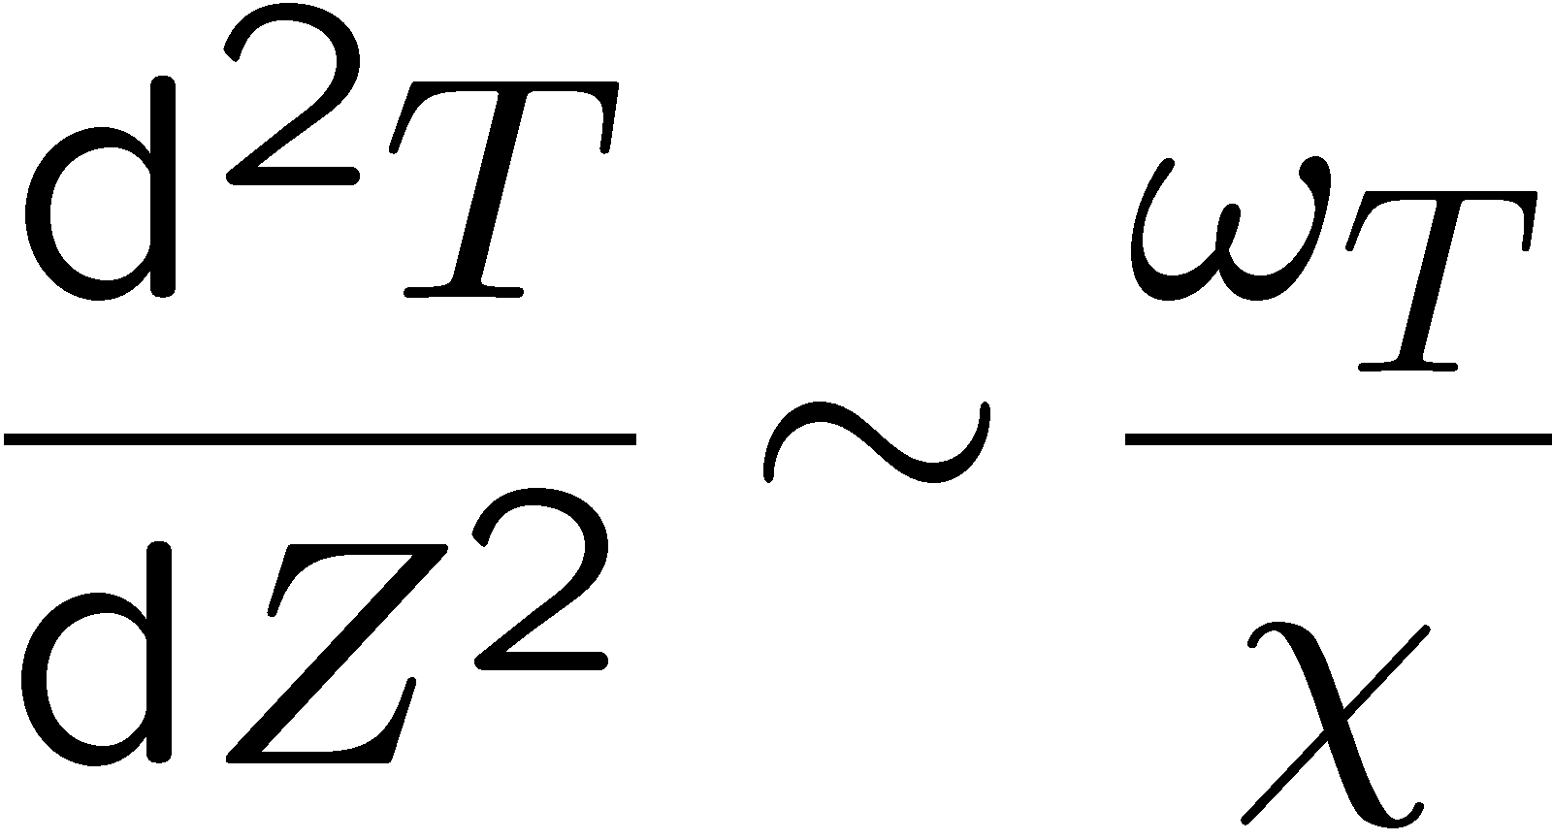
This may be written as
Here the term on the r.h.s., evaluated at and divided by the maximum temperature, may also be interpreted as a Damköhler number.
Inserting this into
the quantity ε becomes proportional to Da^{-1/2}.
14.-59

Slide 35
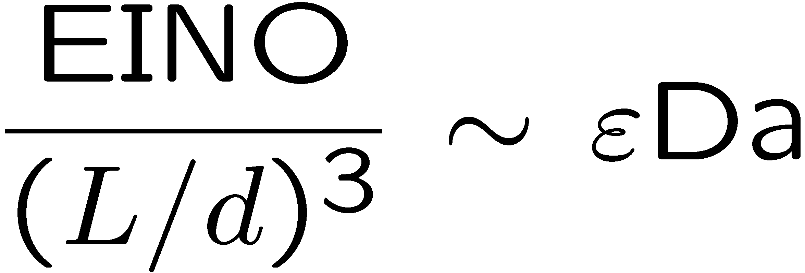
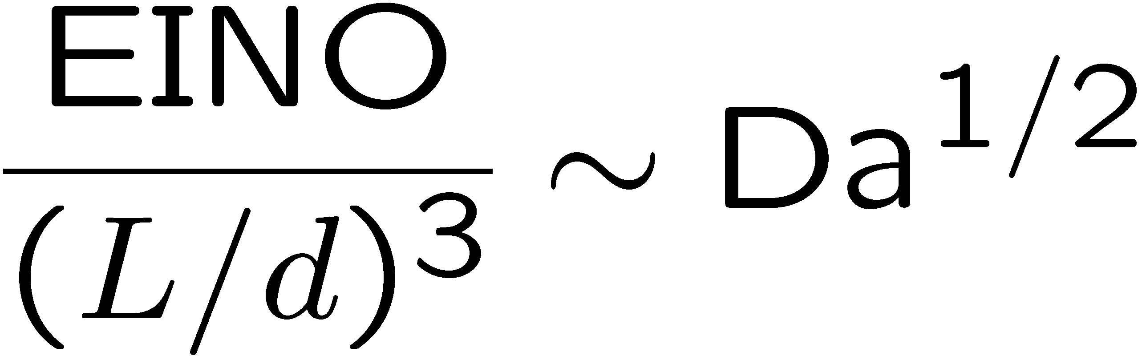
This finally leads with
to
This scaling law indicates that the experimentally observed (d/u⁰)^{1/2} dependence of the rescaled NO emission index is a residence time effect, modified by the temperature sensitivity of the NO reaction rate, on which the asymptotic theory by Peters and Donnerhack (1981) was built.
It also shows that unsteady effects of the flame structure and super-equilibrium O-concentrations may be of less importance than is generally assumed.
14.-60

